Slide 1
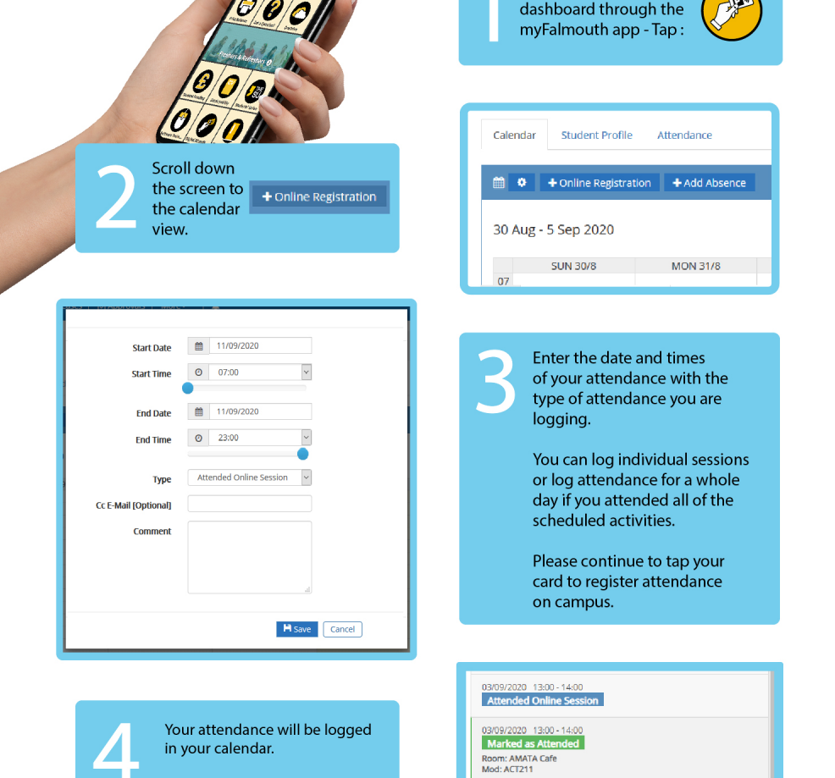
Please Sign In…
The session will start shortly…

Slide 2



Game Analytics
GAM130 8

Slide 3
What is analytics?

Slide 4
A rhetorical question
Suppose you could put your game in front of thousands of players
You can alter your game’s code to measure things about how players play, and report this data back to you
What questions could you answer about your game?
What assumptions could you test?
How could these answers make your game more enjoyable and/or profitable?

Slide 5
Analytics
Analytics is the analysis of data to discover patterns
Related terms:
Data mining
Data science
Big data
Machine learning
…

Slide 6
Why analytics?
Most of our gaming devices nowadays have always-on internet connections
Developers can easily push updates to released games
Games-as-a-service (GaaS) model
Games can easily collect data and send it back to developers
Bandwidth, storage, computer time are cheap
Analytics can take the guesswork out of many game design and business decisions

Slide 7
Feedback loops
Game development is a feedback loop of playtesting and iteration
Gathering and interpreting informal feedback from playtesters is hard
… and even harder when your “playtesters” are your customers (e.g. in early access or GaaS models)
Analytics aims to turn this process into more of a science
The build-measure-learn cycle

Slide 8
Data-driven decision making at Valve
Sources:
https://www.youtube.com/watch?v=HQwL6zh7AgA
http://media.steampowered.com/apps/steamdevdays/slides/data.pdf

Slide 9
Decision making at Valve
Valve favour data-driven decision making
Ask explicit questions
Look at the data
Use the data to develop a theory
Define measurable outcomes
Iterate

Slide 10

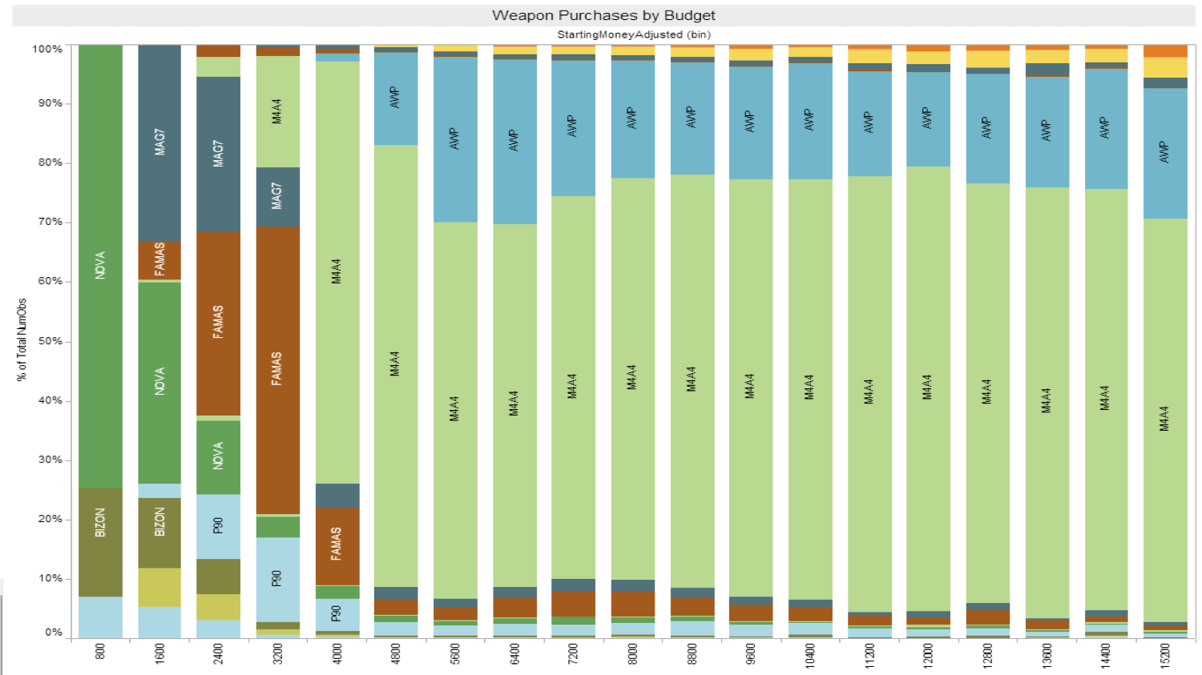
Case study: Weapon choice in CS:GO
Observation: M4A4 usage is high in late game
Explicit question: how can greater choice be introduced in late game?
Data-driven: purchase rates
Theory-driven: greater tactical choice will lead to better player retention
Measurements: purchase rates, playtime, efficacy
Iterative: inform future design choices
Hypothesis: creating a balanced alternative to the M4A4 will increase player choice, thus increasing playtime and retention

Slide 11
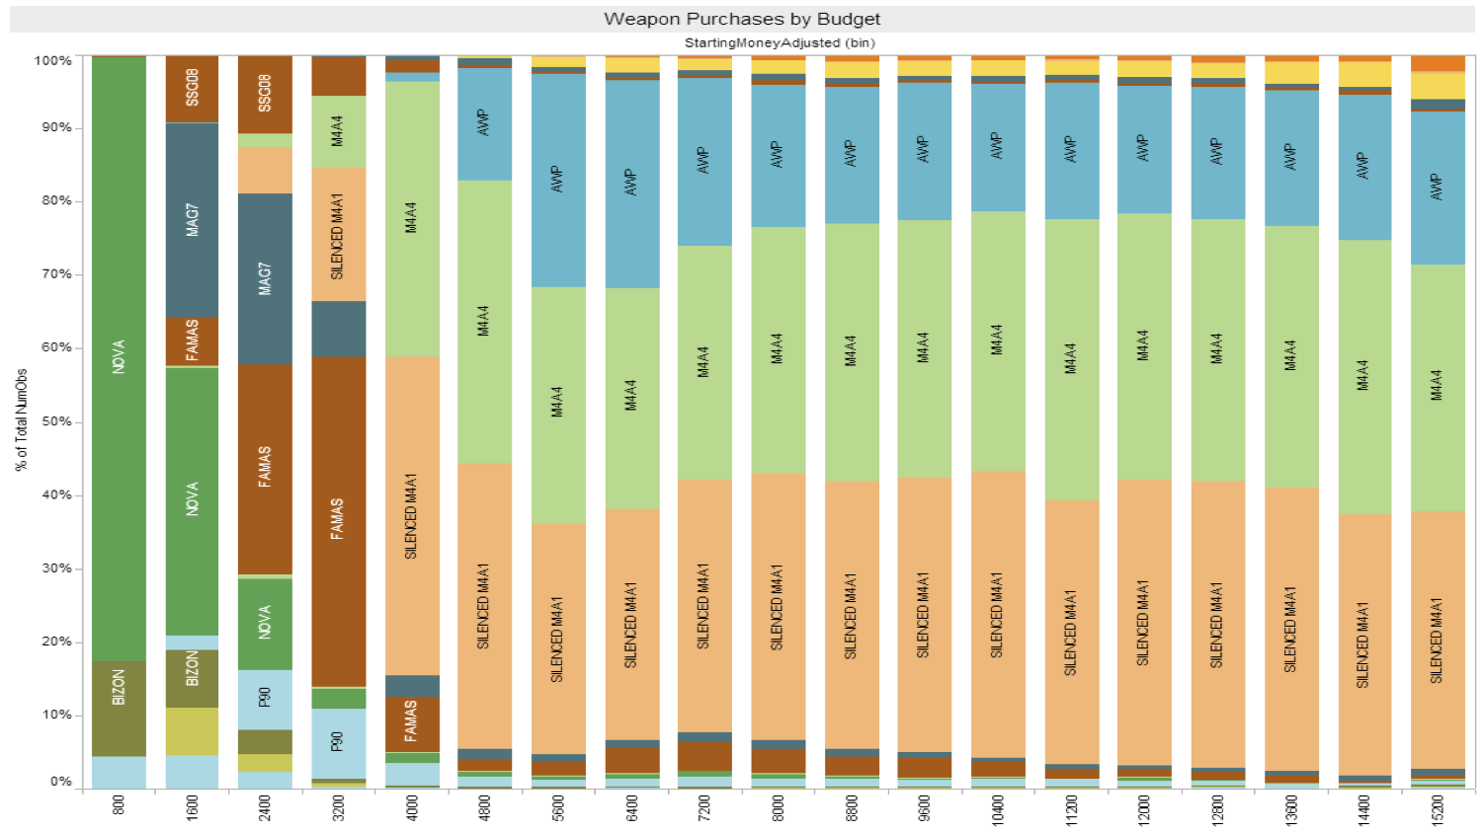
Results
Approximate 50:50 split between M4A4 and new weapon (silenced M4A1)
An increase in playtime was measured…
… however other updates were made at the same time, so this is difficult to isolate
Hypothesis: creating a balanced alternative to the M4A4 will increase player choice…
Yes!
… thus increasing playtime and retention
Maybe?

Slide 12
Data visualisation
Human brains are hard-wired to see patterns
Good data visualisation can help to spot patterns
… however this should be followed up by proper statistical analysis!

Slide 13
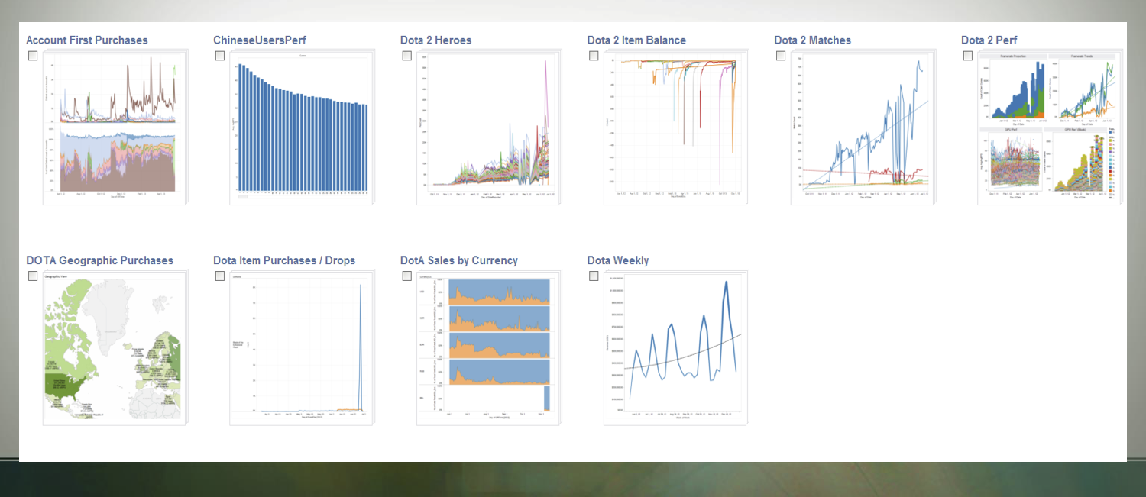
ValveStats dashboard

Slide 14
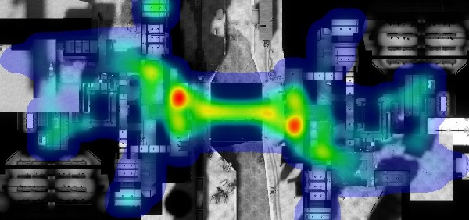
Player deaths in Team Fortress 2

Slide 15

Weapon fire locations in CS:GO

Slide 16
Analysing data

Slide 17
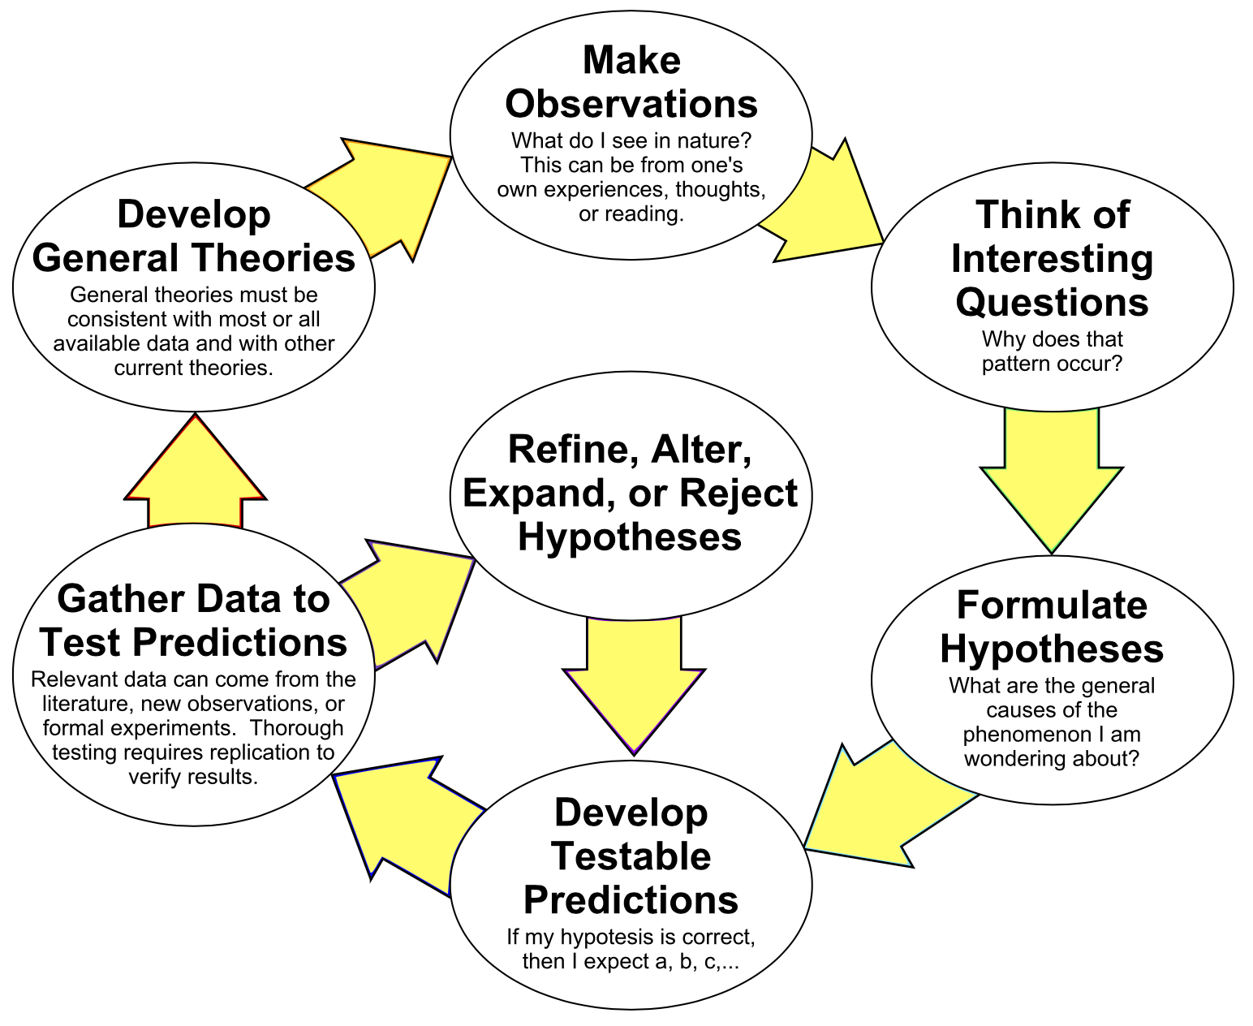
The scientific method
Image source: https://commons.wikimedia.org/wiki/File:The_Scientific_Method_as_an_Ongoing_Process.svg

Slide 18
Statistical significance
Is a D6 biased if…
You roll it once and it comes up a six?
You roll it 3 times and it comes up a six twice?
You roll it 60 times and it comes up a six 59 times?
You roll it 60 times and it comes up a six 11 times?
You roll it 600 times and it comes up a six 110 times?
You roll it 6,000,000 times and it comes up a six 1,100,000 times?

Slide 19
Statistical significance
Every statistical result has a non-zero probability of being a coincidence
Know your confidence intervals
Beware of p-value fishing

Slide 20
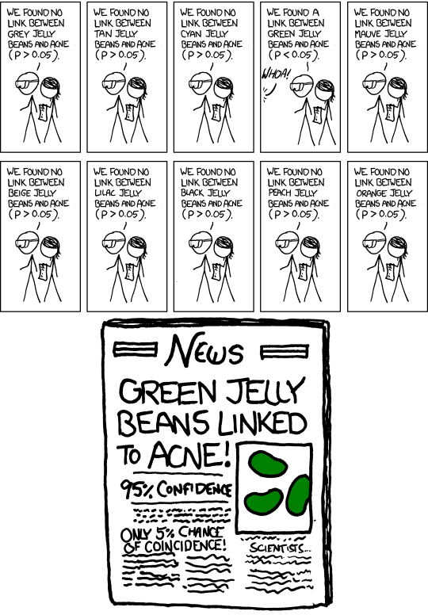
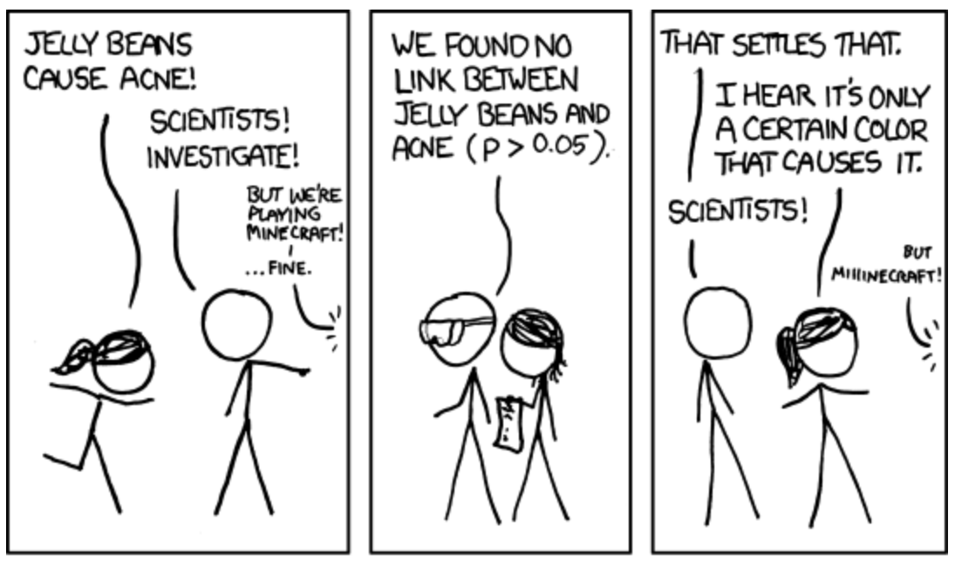
p-value fishing
Image source: https://xkcd.com/882/

Slide 21
Statistical significance vs effect size
High statistical significance does not always mean large effect size
E.g. red team wins 5,010,000 matches out of 10,000,000
This is statistically significant, but only a 0.1% effect size

Slide 22
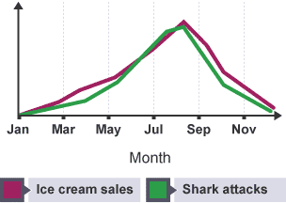
Correlation does not imply causation
Image source: https://www.ibpsychmatters.com/why-correlation-is-not-causation

Slide 23
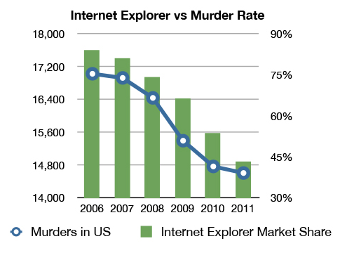
Correlation does not imply causation
Image source: https://gizmodo.com/internet-explorer-vs-murder-rate-will-be-your-favorite-5977989

Slide 24
Ethics of analytics

Slide 25
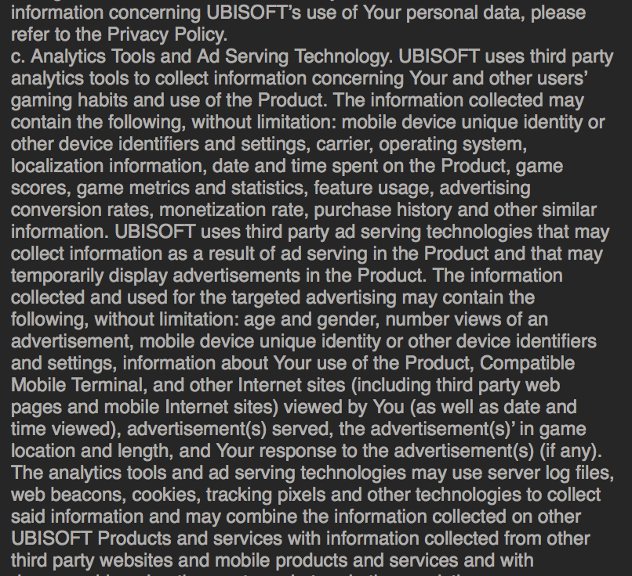
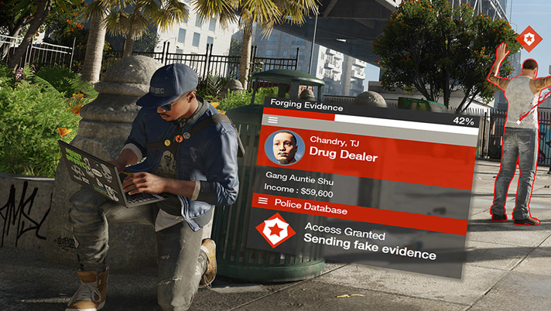
Privacy
There’s a fine line between collecting data and spying
Legal and ethical issues must be considered

Slide 26
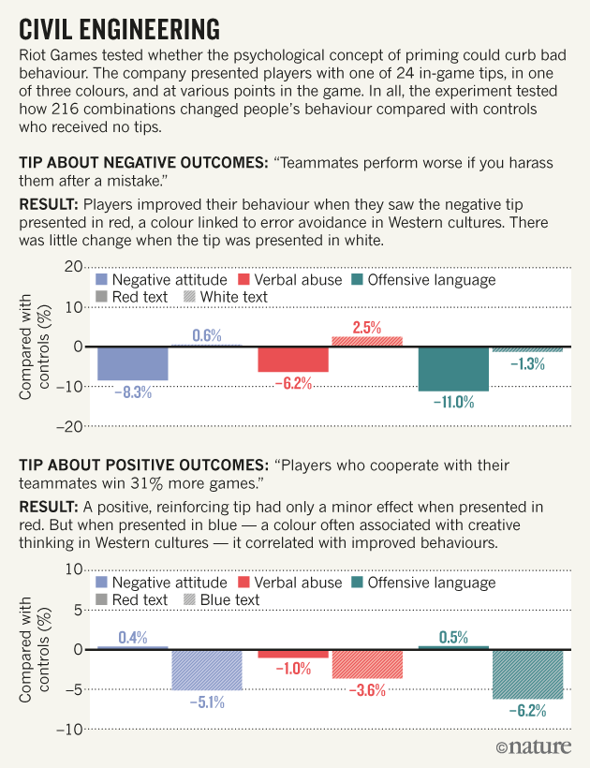
Psychology
E.g. Riot Games tested various priming techniques to curb toxic behaviour in League of Legends
Essentially using players as participants in a scientific experiment
Even if players ultimately benefit, this raises ethical issues
Scientific ethics is founded on informed consent
Image source: https://www.nature.com/news/can-a-video-game-company-tame-toxic-behaviour-1.19647

Slide 27
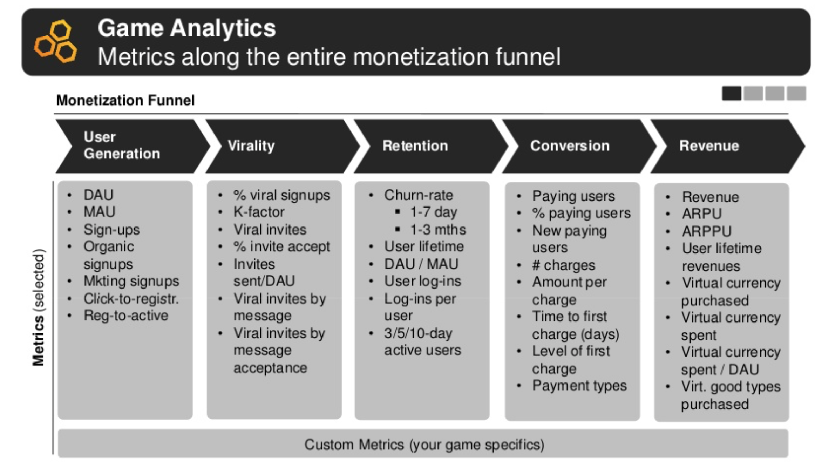
Monetisation
Analytics is a key part of free-to-play (F2P) business models
Profitable F2P games rely on understanding how to acquire, retain, engage and ultimately monetise players
Many legitimate ethical concerns around F2P, especially around adding gambling mechanics or other deliberately addictive qualities to games
Image source: https://www.slideshare.net/TomSente/game-monetization-analytics-how-to-use-your-game-metrics-effectively

Slide 28
Ethical considerations
Are you breaching your players’ privacy?
Is it right to experiment on your players?
Is it right to manipulate your players’ behaviour (even if positively)?
Are you deliberately adding addictive qualities to your game?
How much is justified in the name of improving player experience?
How much is justified in the name of running a viable (i.e. profitable) business?

Slide 29
Legal considerations
I am not a lawyer – this slide is for education only and does NOT constitute legal advice!
Legislation such as General Data Protection Regulation (GDPR) and Data Protection Act
Covers personal data: any data that can be used to identify a living individual
Name, phone number, email address, IP address, social media ID, …
Covers processing (including storage) of personal data
You have certain responsibilities, the subject has certain rights
Not complying can be a civil and/or criminal offence
Other countries have their own laws, with which you must also comply if doing business there

Slide 30
Conclusion
Analytics can be seen as large-scale playtesting with automated collection of quantitative feedback
Allows a scientific approach to game design decisions and to business decisions
However, must be approached ethically and within legal restrictions

Slide 31

GAM130 Roadmap
The next session will cover: Playtesting & QA
The Roadmap:
Week 1 – Builds & Version Control
Week 2 – Managing Team Conflict
Week 3 – Applied Storytelling 1
Week 4 – Visual Vocabulary
Week 5 – Character Design as a Team
Week 6 – *MID-TERM REVIEWS*
Week 7 – Problems in Perception
Week 8 – Game Analytics
Week 9 – Playtesting & QA
Week 10 – Applied Storytelling 2
Week 11 – What is a World?
Week 12 – STUDIO PRACTICE

Slide 32
Thank you
GAM130 8
https://learningspace.Falmouth.ac.uk
edward.powley@falmouth.ac.uk

